Slide 1
ECE Stockroom Web Application
(Ongoing Development)
Group Members: Joaquin Rosendo & Camron Capps
Sponsor: Richard Woodcock

Slide 2
Project Description
Our project is recreating the stockroom website in order to make it modular for future implementations, thoroughly documented, organized, user friendly, mobile friendly, reliable security and overall more efficient.

Slide 3
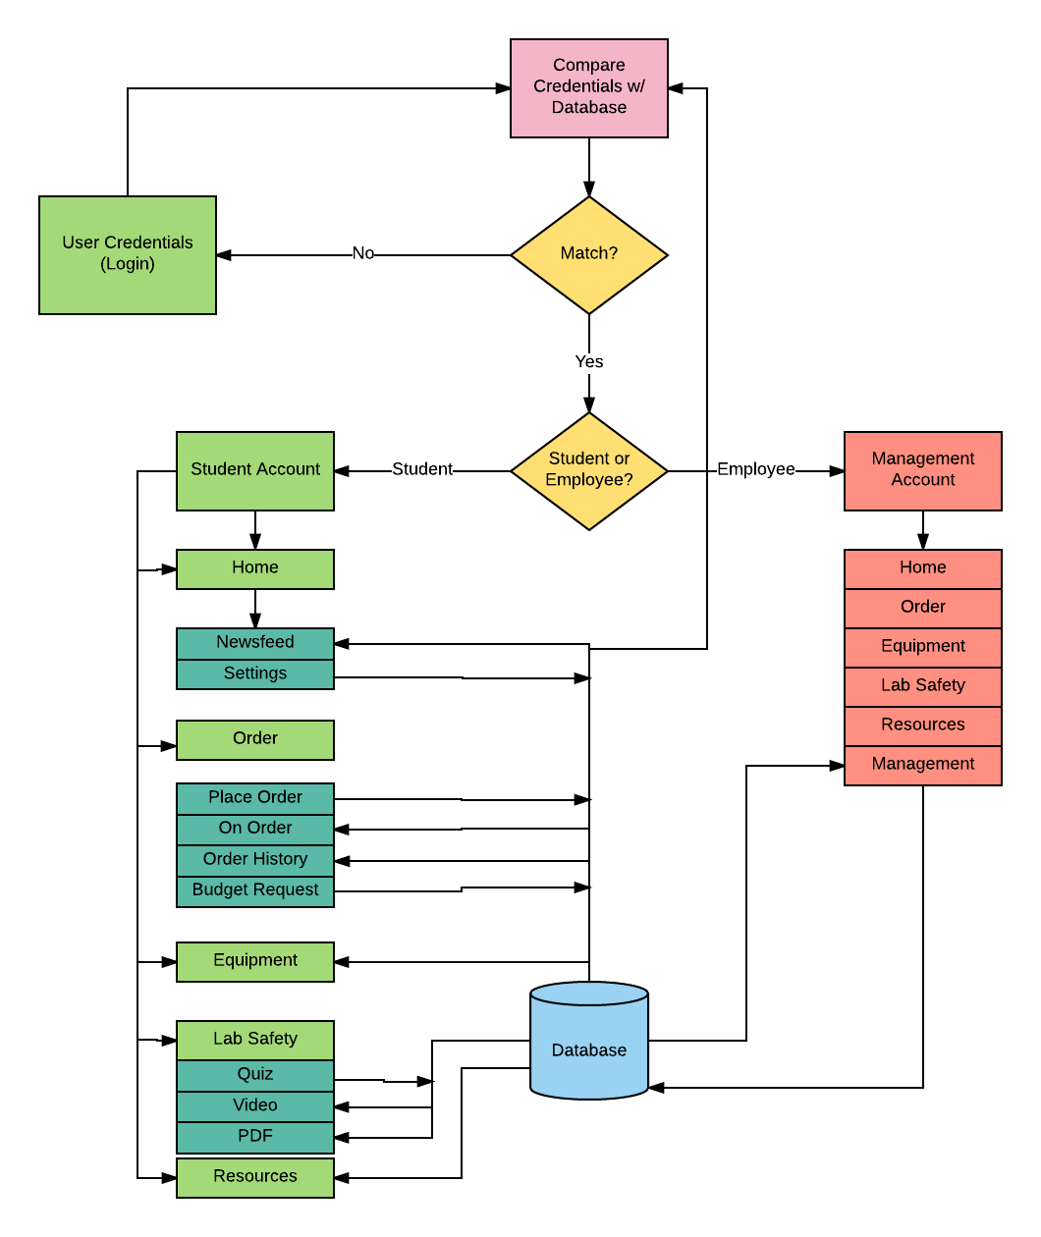
Flow Chart

Slide 4
Routing
Server.js
Navigation.js
Login.js
Equipment.js
Orders.js
...
...

Slide 5
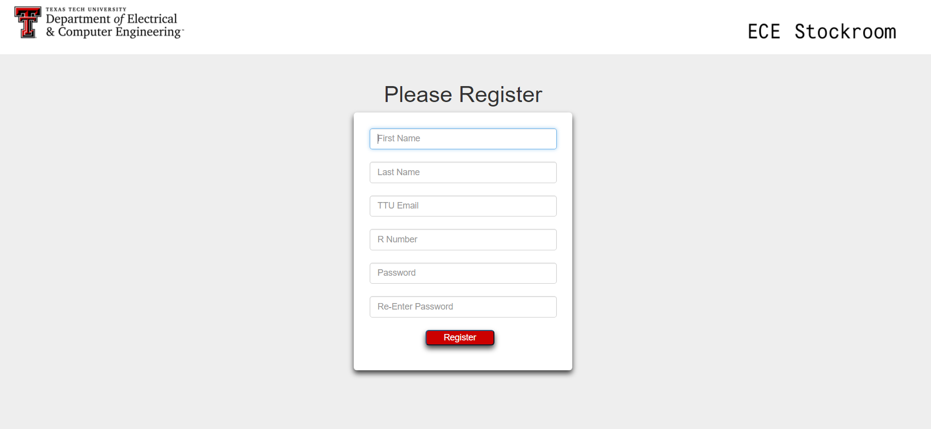
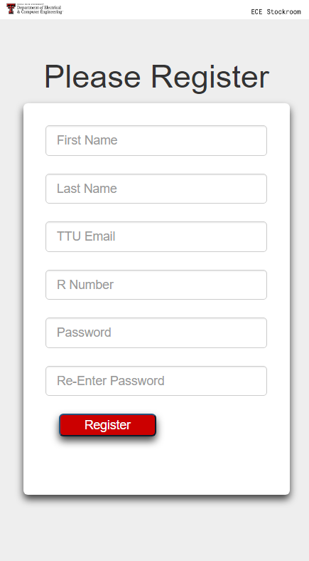
Registration Page

Slide 6
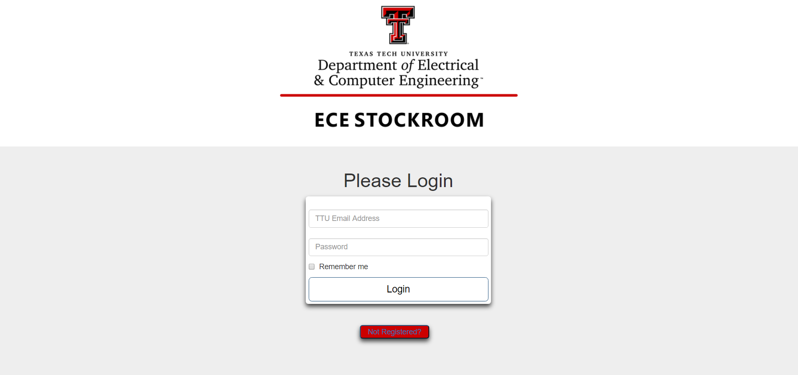
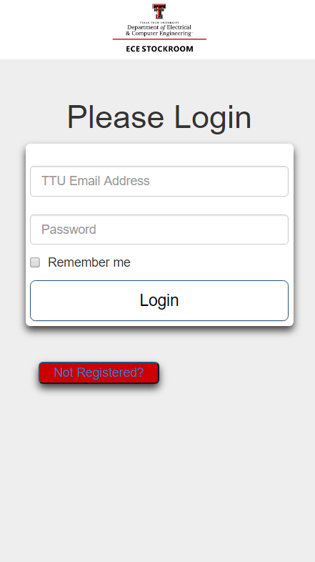
Login Page

Slide 7
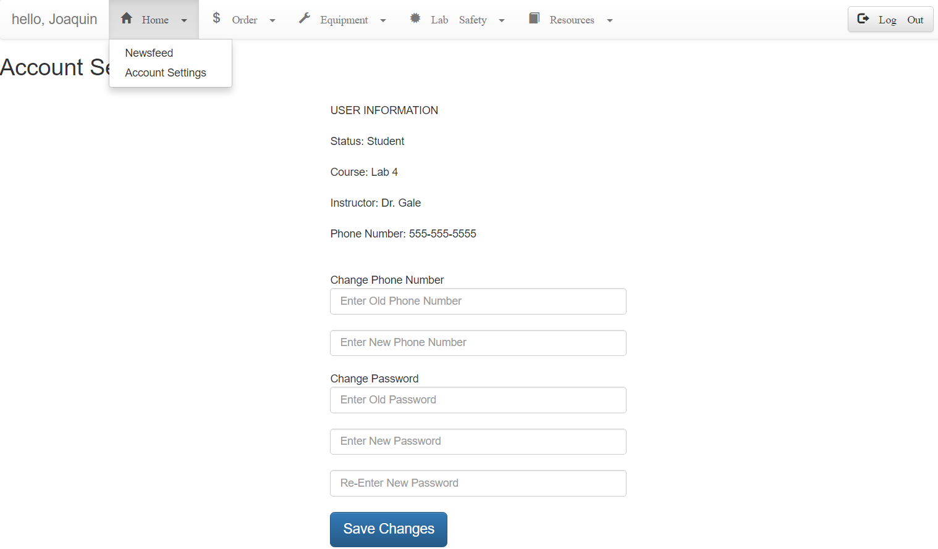
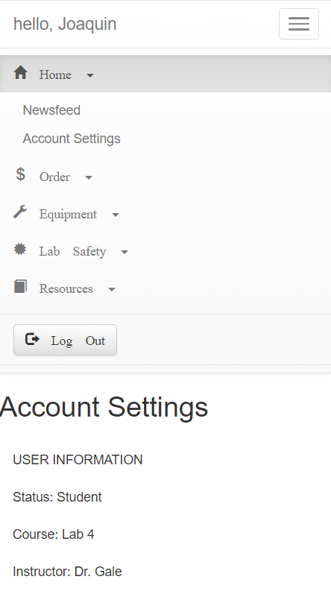
Home Page

Slide 8
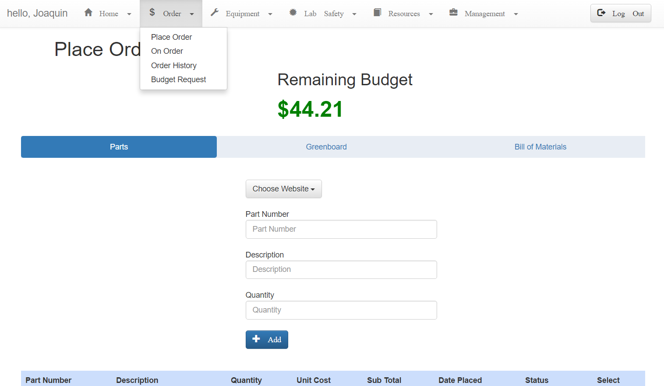
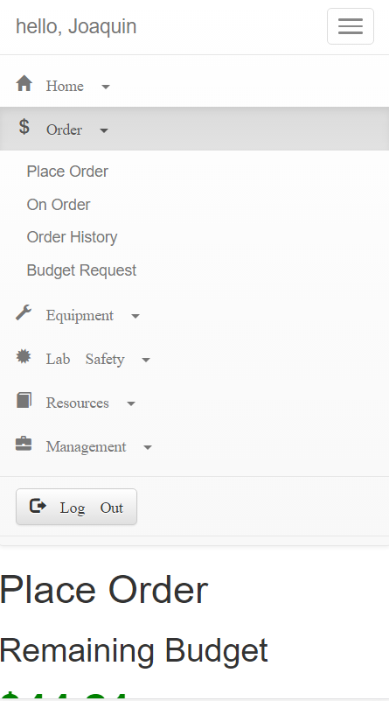
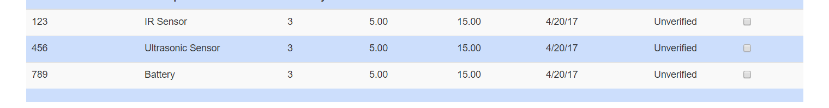
Place Order Page

Slide 9
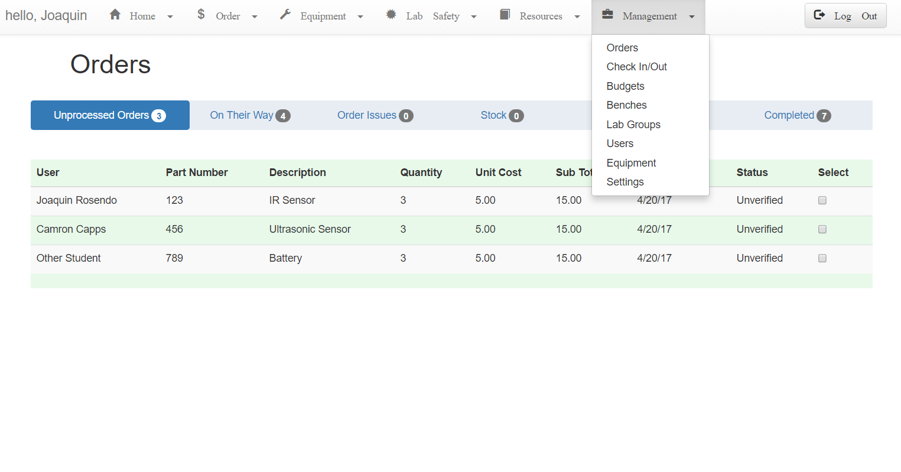
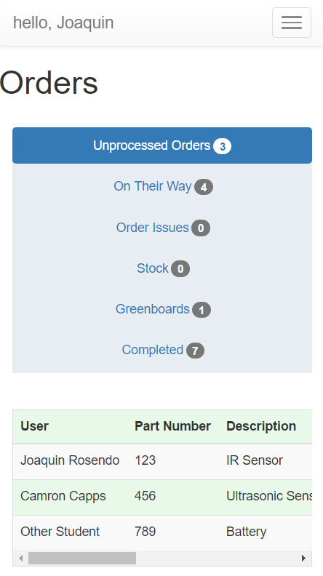
Management - Orders Placed

Slide 10

Mid-Semester Design Changes: Django to NodeJS
Switched from Django to NodeJS
Unlike Django, NodeJS is not restrictive in the way you design the backend.
There is no ‘best way’ to do something. It is very flexible.
It is much easier to understand and learn. (future developers)
More stable than XAMPP. NodeJS has it’s own web server framework that is built to handle strenuous traffic.
https://en.wikipedia.org/wiki/Node.js

Slide 11
Mid-Semester Design Changes: MySQL to MongoDB
Removing XAMPP/MySQL
Tedious layering of user-made software to integrate Django with XAMPP/MySQL.
Implementing NoSQL MongoDB
Specifically designed with NodeJS in mind.
Can switch between raw SQL or use NoSQL.
Uses JavaScript object notation (JSON).

Slide 12

Reconstructing the Database

Slide 13
Real Name | Lab # | Password | Email | Classification | Phone # | R# | Lab Safety | Hazzard Communication | Safety Awareness | Lab Teacher | Budget

Slide 14
Beta Launch scheduled for Summer 1

